Slide 1
Ocean/Tidal renewable energy
By Edvinas Klevinskas and Arnas Švenčionis
iFF-8/11

Slide 2
This type of energy/resource in the Global Energy Context
High build and maintenance costs
Dependant on the weather/currents
Limiting only to coastal countries

Slide 3
Where in the world is this type of energy/resource used the most?
Portugal
United Kingdom
USA
Australia

Slide 4
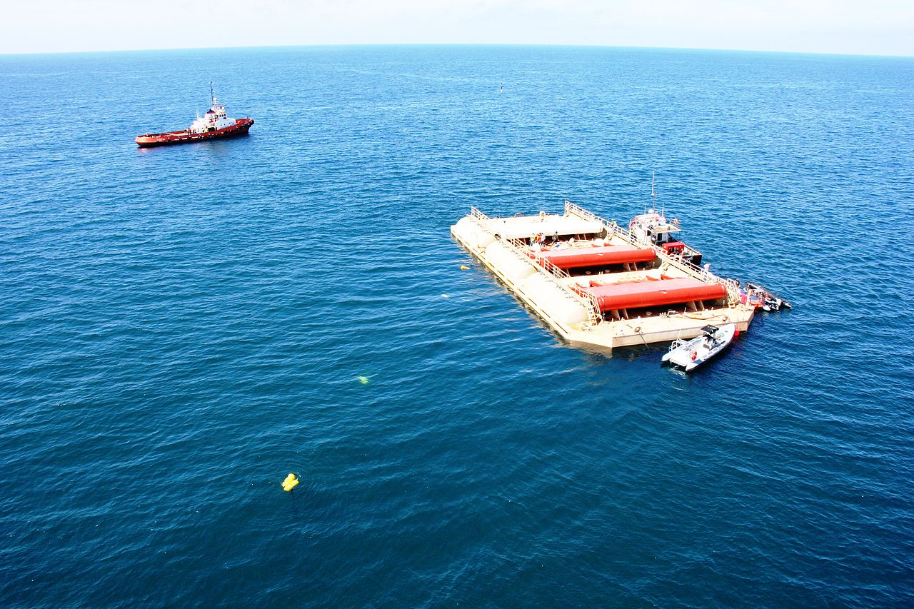

Slide 5
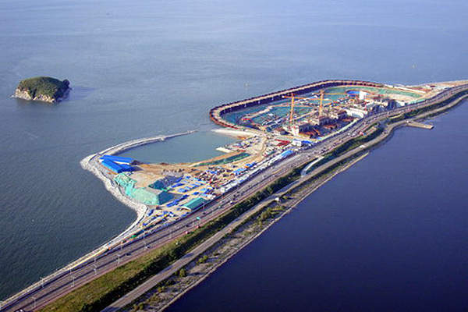
Largest tidal power plant in the world
Sihwa Lake Tidal Power Station

Slide 6
What percentage of this type of energy/resource is used in Lithuania?

Slide 7
What can this type of energy/resource be used for?
Power things?

Slide 8
How is this type of energy/resource easily renewed?
Since the power comes from tides and waves, the energy is easily renewable.
Waves are waves and they won‘t disappear

Slide 9
What are the positive aspects of using this resource/type of energy?
does not harm the environment
Is renewable
Is clean

Slide 10
What are the negative aspects of using this resource/type of energy?
Does not look nice
Can cause pollution in case of spilage

Slide 11
What is the science behind this resource/type of energy?
Waves and tides push pistons up and down, therefore creating mechanical energy which can later be transformed into electrical energy.

